Slide 1
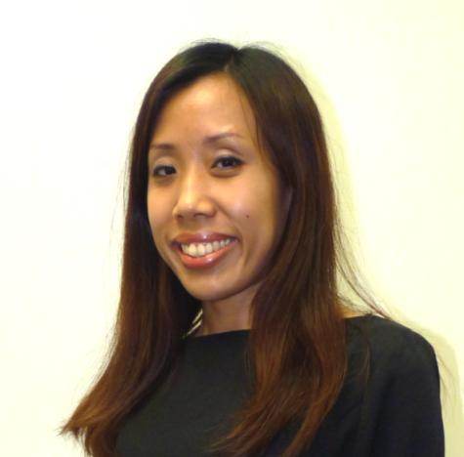
網路中心開拓無限盈利潛力
The Profitable Possibilities with WebCenters
Kirk Kwok
經理級 Executive Coordinator
收到HK$4,600佣金
Receive HK$4,600 commission payment
Wing Kwok
助理級 Coordinator
收到HK$2,300佣金
Receive HK$2,300 commission payment
本簡報中提到的收入等級純屬舉例說明，無意代表美安香港經銷商的一般收入，也無意表示任何經銷商皆可賺取同等收入。美安香港經銷商的成功與否，取決於其在發展事業時的努力、才能與投入程度。The income levels mentioned in the following presentation are for illustration purposes only. They are not intended to represent the income of a typical Market Hong Kong Distributor, nor are they intended to represent that any given Independent Distributor will earn income in that amount. The success of any Market Hong Kong Independent Distributor will depend upon the amount of hard work, talent, and dedication which he or she devotes to building his or her Market Hong Kong Business.

Slide 2
網路中心開拓無限盈利潛力 The Profitable Possibilities with WebCenters

Slide 3
成功的元素 The Elements of Success
我們已經為你打造一條更容易、更好、且更可複製的方法，
讓你成為網路中心用戶並建立超連鎖™事業 ！
We’ve made building your UnFranchise™ as a WebCenter Owner Easier, Better and more Duplicatable than Ever!
產品
The Product
潛力
The Potential
夥伴關係
The Partnership
Notes:
JF will transition into this slide. Components of building your UnFranchise not only easier and more dupicatable.

Slide 4
消費者的誤解 Consumer Confusion
中小企業經營者對網路行銷解決方案的看法：
This is how your prospects feel about choosing a website solution!
我需要甚麼？
網站設計
社交媒體
電子郵件
Google
行動服務網站
電子郵件行銷
客戶關係管理(CRM)
電子商務
安全性
支援
維護
What Do I Need?
Web design
Social Media
Email
Google
Mobile Site
Email Campaigns
CRM
E-Commerce
Security
Support
Maintenance
我怎麼取得？
傳統的網站開發公司
自己製作
折扣代管服務供應商
印刷/黃頁公司
朋友協助
家人協助
等待
How Can I Get It?
Traditional
Do It Myself
Discount Provider
Print Company
Friend
Family Member
Wait
Notes:
SR It starts with having a great product. The market is really

Slide 5
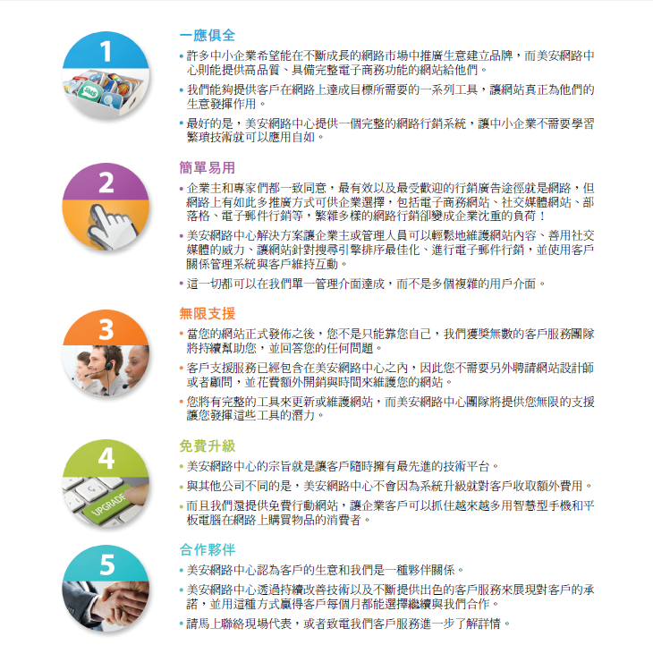
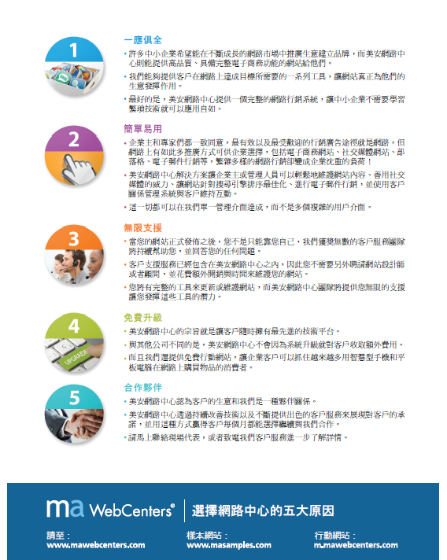
簡易的解決方案 The Simple Solution
Notes:
SR

Slide 6
Very Simple
非常簡易
簡而言之，我們能夠幫助中小企業(SMB)：
增加收益
減少開支
提升顧客滿意度
這是一個證實可行且可複製的系統，可為小企業經營者提供一個有效的互聯網店面！
你如何做到這樣？ 這是一個很簡易的銷售系統 ：
你跟產品專員約定一個銷售會談
設計中心可為顧客創建一個完全客製化的網站
顧客服務為你的客戶處理技術支援
Very simply, we can help small-medium sized businesses:
Increase Revenues
Decrease Expenses
Increase Customer Satisfaction
By helping SMB to have a better online marketing strategy and simplifying the process!
So how do you do that? It’s a Simple Sales System:
You schedule an appointment with Product Specialists
Design Center can design a customer design
Customer Care will handle all tech support for clients
Notes:
SR

Slide 7
獲利潛力 – 現在
只要產生零售利潤，你便可支付那些固定成本
平均網站銷售費用為港幣10,100元
這樣就能賺取港幣7,800元的零售利潤！
帶著你的目標，算一算是港幣7,800元的幾倍，這樣你就知道該賣掉幾個網站，就能達成目標
Earning Potential: NOW
You can cover the cost of your fixed-cost goals by generating retail profits.
The average website sale is $10,100
That generates about $7,800 retail profit!
Take your goals, break them down into $7,800 increments to get an estimate of how many website sales you’d need to make to achieve those goals
Notes:
JF We just described the process – and what was your role in that? Exactly! You schedule appointments. So yes, you earn on average about $1,000 per sale for scheduling appointments. As UFOs, that is one of the biggest things we do – everyone in this room is already leveraging the skill set that it takes to be successful with WebCenters . Just sell appointments.

Slide 8
獲利潛力 – 未來
整體大局為何？
每賣出一個網站，可得230業績點數(BV)
此外，每有一位活躍客戶，每個月就可賺取30 BV
這30 BV會自動計入你的帳戶。當你登入網路中心時，可以管理BV
這代表只要有10位活躍網站客戶，每個月你就可產生300 BV
當你評估長期目標時，記得把這些BV列入考慮
終極目標是複製基本10顧客，7人強。
Earning Potential: FUTURE
What about the big picture?
Each Website sale generates 230 BV
In addition, you earn 30 BV/Month for each active client!
The 30 BV is automatically billed and credited to you. You can manage your BV when you login to your WebCenter.
That means just 10 active website clients would generate 300 BV per month
Keep the BV in mind when factoring this into your long-term goals as well.
The Ultimate Goal is to Duplicate Base 10, 7 Strong.
Notes:
JF

Slide 9
Recruiting WebCenter Owners
招募網路中心用戶
從未如此簡單與人分享「網路中心商機」
http://hkinfo.com.hk/
美安網路中心計劃
網路中心用戶的好處
產品和服務
給予網路中心用戶支援
成為網路中心用戶
網路中心主修概覽，101和201訓練
由網路中心授證訓練員主講及舉辦
你可選擇不需主修網路中心來發展你的超連鎖™事業！
你只需懂得如何利用網路中心提供的支援及其資源！
We’ve made it easier than ever to share “The WebCenter Opportunity”
http://hkinfo.com.hk/
The Market America Plan
Benefits of WebCenter Owners
Product and Services
Support for WCOs
Become a WebCenter Owner
WebCenter UMO, 101 and 201 trainings
Conducted by CWTs
You do not have to major in WebCenters to grow your UnFranchise™ with WebCenter owners!
The support for WCOs is there- you just need to know how to use your resources!
Notes:
JF

Slide 10
網路中心與新興市場計劃(EMP) EMP & WebCenters
你在任何一個國家成功銷售網站，所得到的將會是本國的零售利潤和本國的業績點數。
你的網路中心可在全球銷售網站，將網站銷售至所有市場國家/地區及新興市場計劃國家/地區！
A website sale in any country will result in home country retail profit and home country BV!
Your WebCenter will be automatically enabled to sell websites globally in Market Countries and EMP Countries!
市場國家/地區 Market Countries | 新興市場計劃國家/地區 EMP
美國 USA 加拿大 Canada 墨西哥 Mexico 澳洲 Australia 台灣 Taiwan 香港 Hong Kong 英國 UK | 西班牙 Spain 哥斯達黎加 Costa Rica 多明尼加共和國 Dominican Republic 哥倫比亞 Columbia 厄瓜多爾 Ecuador 巴拿馬 Panama | 新加坡 Singapore 紐西蘭 New Zealand 菲律賓 Philippines 其他任何我們可以在語言和時間上提供支援的國家/地區！Any other country that we can support the language and support hours!
Notes:
JF

Slide 11
網路中心與新興市場計劃(EMP) EMP & WebCenters
這代表你的網路中心可在中國銷售網站!
That means with the new WebCenterEMP Program you could even sell in:
Mainland China!
Notes:
JF

Slide 12
Ways to Ramp up your WebCenter Business
擴展你網路中心業務的方法
網路中心90天快速成功計劃
參加網路中心不同的訓練
WebCenter 90 Day Fast Track
Get to a Certified WebCenter Training
Notes:
SR

Slide 13
網路中心授證訓練101 WebCenter Certification training 101
「網路中心成功之道」
“Succeeding with WebCenters”
Notes:
Take advantage of wct101

Slide 14
WebCenter Certification training 201
「透過社交網路邁向成功之道」 藉由美安網路中心進行進階銷售與建立社交網路
“Networking your way to success” Advanced Selling & Networking with maWebCenters
網路中心授證訓練(WCT) 201
WebCenter Certification Training 201
Notes:
Take advantage of wct201

Slide 15
WebCenter Fast Track for Success
網路中心快速成功計劃
結果
賣出153 個網站
共有美金$154,594.00（約港幣$1,205,833.2） 網站零售利潤
超過美金$250,000（約港幣$1,950,000） 美安產品的零售利潤
個人親自推薦195位夥伴
新增340位夥伴
新增46位經理級、25位助理級、2位主管經理級和3位資深主管經理級經銷商
90天快速成功計劃
把每天的努力和付出加起來!
建立良好經營業務和網路中心的習慣
需意志堅定，持續地行動
為自己所做的行動負責和做紀錄
打造團隊士氣
獲得成果
The 90 day Fast Track
Small efforts each day add up!
Create good Business & WebCenter habits
Be consistent
Be accountable
Build Momentum
Get Results
Results
153 Website Sales
US$154,594.00 (arround HK$1,205,833.2) Retail Profit
Over ¼ Million US Dollars (around HK$1,950,000) in ma Products
195 Personally Sponsored
340 Additional Partners
46 Coordinators, 25 EC, 2 MC, 3 SMC
Notes:
SR A lot of the ideas for the new trainings came from lessons learned from The 90 Day Day Fast Tracks. We’ve had 3 extremely successful 90 day fast tracks. So let’s talk about the fast track.

Slide 16
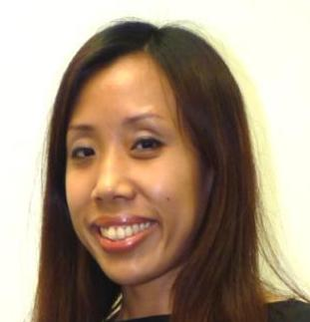
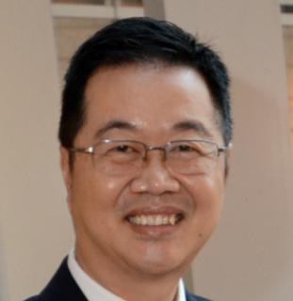
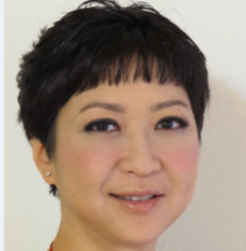
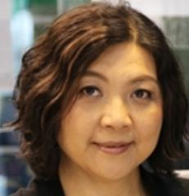
90天快速成功計劃教練 90 Days Fast Track Coaches
Christine Ho
Kirk Kwok
Wing Kwok
Mark Li
Frances Siu
Maggie Su
Simon Sze
Hilda Wong
Reginia Wong

Slide 17
Join the Fast Track!
加入90天快速成功計劃!
你可免費登記並立即加入網路中心90天快速成功計劃!
請到: https://www1.gotomeeting.com/register/705501496
步驟一: 登記快速成功計劃
步驟二: 登記逢星期一晚上10時，由香港網路中心授證訓練員主辦的 網絡會議Webinars
步驟三: 下載學員手冊
You can join us on the WebCenter 90 Day Fast Track and Register for Free!
Go to: https://www1.gotomeeting.com/register/705501496
Step 1: Register for the Fast Track
Step 2: Register for 10pm Monday Hong Kong Coaching Webinars
Step 3: Download the Welcome Packet

Slide 18
開始起步 - 購買快速起步套裝 Getting Started - Fast Start Kit!
新的事業夥伴由此起步！HK$3,237
Get a New Business Partner Started! HK$3,237
主管級超連鎖™事業 （300 BV及3個商業發展中心）
獨立經銷商全套入門資料
建立事業資料
美安網路中心 – 由美安網路中心專業團隊提供支援
Master UnFranchise™ Business (300 BV & 3 BDCs)
Independent Distributor Subscription Kit
Business Building Materials
maWebCenter – backed by maWebCenters Teams of Professionals
Notes:
JF

Slide 19
成功的行動計劃：成為網路中心用戶！ Checklist for Success: Become a WebCenter Owner!
WebCenter Special
2014美安香港年會期間，凡購買3張2014美安香港領袖訓練會議門票，即可免費獲贈美安香港網路中心*
During HK AC 2014, purchase a minimum of three 2014 Hong Kong Leadership School tickets in a single order and you’ll receive: Your own Market Hong Kong WebCenter™* For FREE!
*網路中心月費為港幣$351元
WebCenter monthly service fee is HK$351/month
Notes:
JF you do this one!

Slide 20
網路中心開拓無限盈利潛力 The Profitable Possibilities with WebCenters

Slide 21
嶄新的公司，嶄新的機會，嶄新的你
2014美安香港年會
mhk Annual Convention
#MHKAC2014

